Slide 1

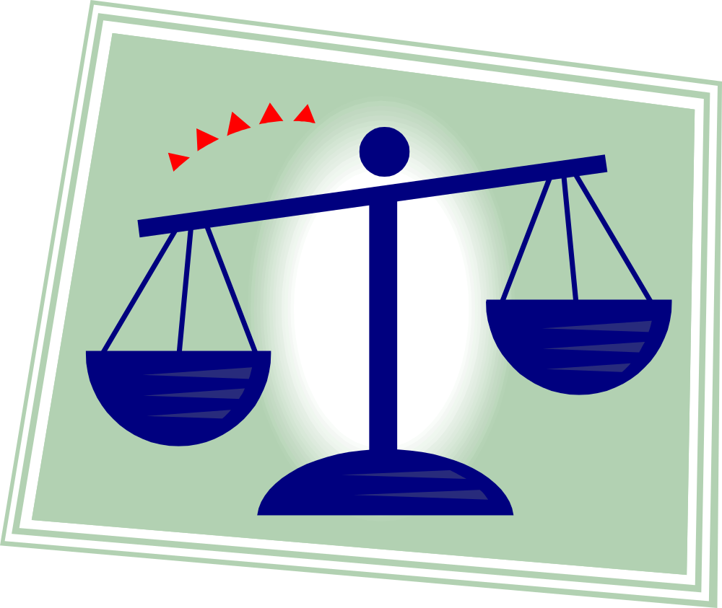

Pleading, Judgments, and Other Stuff

Slide 2




The Bad Old Days
Two kinds of courts: law and equity
The plaintiff had to pick the right writ and form of action: actions for trespass versus trespass-on-the-case
The defendant had to pick the right kind of fancy reply and submit it at the right time: demurrer, dilatory pleas, traverse, confession and avoidance, and a bunch of other stuff.
This was way too complicated!

Slide 3
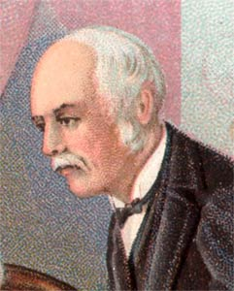
The More Recent, But Still Bad Days: The Field Code
The Code combined the law and equity systems.
It limited the number of kinds of pleadings you could have.
It tried to eliminate the need for elaborate, highly technical pleading.
But the lawyers, who were used to the old system, made a game of it! What’s a “fact”? What’s a “cause of action”?
Nice try, Field.

Slide 4
How much stuff should you have to include in your complaint?
A lot?
  Do we want to use the initial stage of pleading to weed out meritless claims?
  How about protecting the defendant’s reputation from scurrilous allegations?
A little?
  Maybe we should get suits into court and then figure things out from there.
  We could argue that the main function of a civil complaint is to put the defendant on notice that they’re being sued.

Slide 5
Pleading under the Federal Rules
Rule 8: the “keystone” of the Federal Rules! It says: you don’t need to plead with a lot of particularity!
This is notice pleading.
Note the exception in Rule 9: fraud and mistake must be pleaded with particularity.
All we do is put the defendant on notice that they’re being sued and what for. We’ll perform the other pretrial tasks using motions and discovery.

Slide 6
An example…it’s easy!!!
Complaint for Negligence (From FRCP Form 9)
Allegation of jurisdiction.
On June 1, 1936, in a public highway called Boylston Street in Boston, Massachusetts, defendant negligently drove a motor vehicle against plaintiff who was then crossing said highway.
As a result plaintiff was thrown down and had his leg broken and was otherwise injured, was prevented from transacting his business, suffered great pain of body and mind, and incurred expenses for medical attention and hospitalization in the sum of one thousand dollars. Wherefore plaintiff demands judgment against defendant in the sum of ____ dollars and costs.

Slide 7
Rule 11
Rule 11(a) says that you have an obligation, as an attorney, to sign every piece of paper that’s ultimately filed in the court, like pleadings and motions.
Rule 11(b) says that by signing the stuff, you are certifying that what you say in that document has been formed after a reasonable inquiry, that it’s not being used for improper purposes (harassment or delay), and that your claims are warranted by existing law or a good-faith effort to change the law. You’re promising that you’ve done your research and you have a good-faith basis to make the motion you’re making.
Rule 11(c) lists the bad stuff that could happen to you if you violate 11(b)!

Slide 8
Pre-answer motions
All 12(b) motions are potential pre-trial motions to dismiss a case without it having to go to trial. Rule 12(g) and (h) establish which of these get waived if you fail to bring them at the earliest possible time.
Rule 12(h) tells us three things:
  You’ve waived personal jurisdiction, venue, insufficiency of process, and insufficiency of service of process if you didn’t do these right off.
  We protect a 12(b)(6), failure to state a claim, as well as 12(b)(7), failure to join an indispensable party under Rule 19, which can be raised all the way up to the time of trial.
  But subject matter jurisdiction can be raised at any time, even by the court itself without any action from the parties. Subject matter jurisdiction is the most favored defense.
At some point, the court wants to go ahead and go forward with a matter even though there may be problems with certain issues like personal jurisdiction. This is the equity/efficiency tradeoff: if you wait too long, you waive your right to have your motion heard.

Slide 9



Answer
Answers contain:
  Denials
  Affirmative defenses
  Counterclaims

Slide 10
Denials
Denials are described by Rule 8(b).
You need to admit or deny each allegation of the plaintiff.
If you don’t have enough information to admit or deny, you say so and that operates as a denial.
When you intend to only deny part of the allegations, you must say so explicitly.
If you fail to deny an allegation in your answer, it’s deemed admitted! In other words, if you don’t say anything about a certain allegation, it’s like you’re saying it’s true.

Slide 11
Affirmative defenses
You must include any affirmative defenses you may have in your answer.
  Rule 8(c): Affirmative Defenses.
  In pleading to a preceding pleading, a party shall set forth affirmatively accord and satisfaction, arbitration and award, [blah blah blah], waiver, and any other matter constituting an avoidance or affirmative defense.
For example, you would want to include the defense of the statute of limitations. You might admit that you did wrong, but claim that it’s too late for the plaintiff to sue.

Slide 12
Counterclaims
The last part of the answer is any claims you, as the defendant, may have (counterclaims).
Counterclaims are governed by Rule 13. There are two types:
  Compulsory counterclaims – Rule 13(a): If a claim arises out of the same transaction or occurrence, you must “use it or lose it”. In other words, if you don’t bring it now, you could be precluded from bringing it later! (More on this shortly.)
  Permissive counterclaims – Rule 13(b): You may raise claims against the opposing party that don’t arise out of the same transaction or occurrence. But don’t forget: the court will still have to have subject matter jurisdiction over the claims!

Slide 13




Preclusion
Preclusion prevents “two bites at the apple”. It promotes efficiency in the courts!
Claim preclusion
  Also known as res judicata
Issue preclusion
  Also known as collateral estoppel

Slide 14
Claim preclusion (res judicata)
Claim preclusion forbids a party from relitigating a claim that should have been raised in former litigation.
If a claim comes out of the same “nucleus of operative facts” then, for efficiency reasons, we want people to bring all the claims at one time.

Slide 15
Requirements for claim preclusion
There must be a final judgment.
The judgment must be “on the merits” (as opposed to, say, dismissal for improper venue or lack of personal jurisdiction).
The claims must be the same in the first and second suits.
The parties in the second suit must be the same as those in the first (or must have been adequately represented in the first suit).

Slide 16
Issue Preclusion (collateral estoppel)
Issue preclusion is when
  an issue of fact or law is actually litigated
  and determined by a valid judgment
  such that the determination is conclusive in a subsequent action between the parties, whether on the same or different claims.
Issue preclusion only affects the status of specific issues, not whole claims.
Same reason as claim preclusion: why waste our resources finding out the answer to a question again when the question has already been answered?

Slide 17
Requirements for issue preclusion
The issue in the second case must be the same as the issue in the first case.
The issue must have been actually litigated.
The issue must have been actually decided.
The issue that was decided must have been necessary to the court’s judgment.
BUT…
An issue can be precluded from consideration of an entirely new claim between the two parties!

